Slide 1
Audio Editor/Sampler
App Project Pitch 3/7/18

Slide 2
Motivation
-As of today there are tons of offerings for audio-related applications on the android and ios app store.
-Each of which have small flaws
-FL Studio and Caustic create a walled garden with little interconnectivity to
a main DAW (Digital Audio Workstation)
-Sunvox, Famitracker clones normally praised for limitations are more
limited with a touchscreen.
-None of these are suitable for editing audio!

Slide 3
Proposal
To build a native audio editing application with simple controls for performing simple tasks.
-Capable of editing short audio clips or cutting audio down
-Looking at statistics for audio
-Advanced playback features (Looping, Recording, Sampling)
I plan to use the features of other open source android projects alongside this one including Spectroid and Sunvox

Slide 4
App Features
Timeline support- Allows basic scrubbing, cutting and moving of audio on a timeline.
Markers- Placement of markers for either notetaking, looping or advanced playback.
Advanced Features- These are stretch goals for the project but the ability to either support Ableton Link, Sony LDAC (android 8.1 only) or at the very least MIDI triggering over USB

Slide 5
Phone Requirements
-minimum requirements would include a sound chip with a dedicated output device
-A display capable of displaying a timeline in a comfortable way alongside other UI dedicated to holding settings and other parameters
-Android 8.1 if deciding to support LDAC; otherwise a base of Android 5.0 will be used

Slide 6
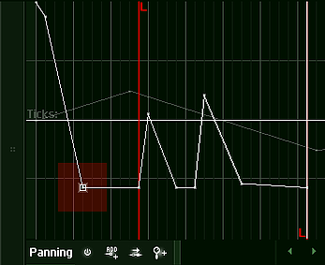
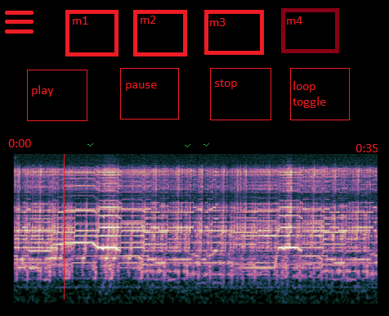
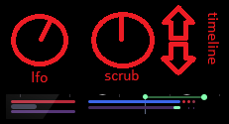
Mockups

Slide 7
Project Timeline
Week 1- Start peeling apart other open source solutions and learning about how they access sound buffers, how audio can be imaged and displayed graphically.
Week 2- Implementation of a basic audio imager- Being able to visualize the audio on some kind of linear view.
Week 3, 4, 5- Implementation of a marker for the audio along with attempting to control playback through a sort of timeline.
Week 6, 7- If playback features are achieved, Start working on timeline functionality, being able to import multiple tracks
Week 8- Any stretch goals that may be achieved. Polishing, bug cleanup.

Slide 8
Anticipated Deliverables
-Minimum: A basic app that allows opening audio files and displaying their outputs as a graphical ‘wave’.
-Achieved minimum goals: An app that allows opening or recording of an audio clip that can be moved around on a timeline with the full timeline (including empty space) being “playable”
-Achieved additional goals: An app that fully allows marker positioning, clipping, freedom of movement of clips and playback along a timeline of up to 15 minutes.
-Exceeding expectations: All of the above, plus allowing the user to trigger from markers using a set of pads, or the enabling of some external feature.

